Slide 1
User-defined Exceptions in Python
DVT101 – Lecture 44
- By Dataverse Tutorials

Slide 2
What are User-defined Exceptions?
Meaning of custom exceptions
Difference from built-in exceptions
Why developers create their own errors
Application-specific error handling

Slide 3
Why Built-in Exceptions Are Sometimes Not Enough
Generic error messages limitation
Business logic validation needs
Domain-specific failures
Readability and debugging challenges

Slide 4
Real-World Motivation for Custom Exceptions
Age validation in forms
Banking and transaction rules
Authentication and authorization checks
Data validation pipelines

Slide 5
Relationship with Built-in Exception Hierarchy
Inheriting from Exception
Inheriting from specific built-in exceptions
Where custom exceptions fit
Why inheritance matters

Slide 6
Steps to Create User-defined Exceptions
Defining a new exception class
Raising the exception
Catching the exception
Clean error flow design

Slide 7
Designing a Meaningful Exception Class
Naming conventions for exceptions
Storing contextual information
Custom error messages
Improving clarity for developers

Slide 8
Using the raise Keyword with Custom Exceptions
When to raise exceptions manually
Guarding invalid program states
Fail-fast principle
Preventing silent bugs

Slide 9
Basic User-defined Exception
Custom exception for validation
Passing data into exception
Triggering on invalid condition
Safe handling using try-except

Slide 10
Understanding init in Exception Classes
Why init is overridden
Storing extra attributes
Calling parent constructor
Exception object lifecycle

Slide 11
Understanding str in Custom Exceptions
Purpose of readable error messages
How str improves debugging
User-friendly output
Logging advantages

Slide 12
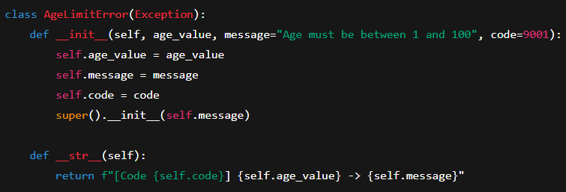
Program Concept: Enhanced Custom Exception
Adding error codes
Attaching metadata to exceptions
Structured error information
Professional application design

Slide 13
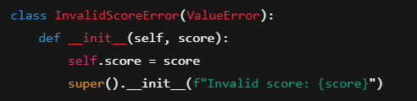
Using Standard Exceptions as Base Classes
Inheriting from ValueError
Inheriting from RuntimeError
Semantic correctness
Integration with existing handlers

Slide 14
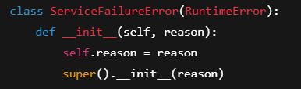
Program Concept: Custom Exception from RuntimeError
Why choose RuntimeError
Treating errors as system-level
Compatibility with frameworks
Controlled escalation

Slide 15
Real-world Example: Input Validation Errors
Email format validation
Username rules
Password constraints
Clear feedback to users

Slide 16
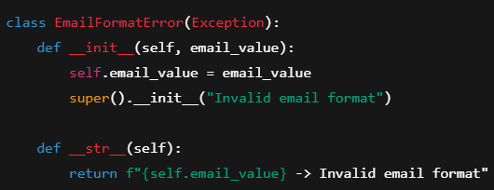
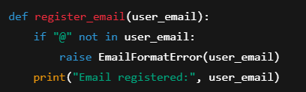
Program Concept: Real-world Validation Exception
Raising exception on invalid input
Clean separation of logic
Centralized error handling
Maintainable codebase

Slide 17
When NOT to Use User-defined Exceptions
Overusing custom errors
Simple cases vs custom logic
Performance considerations
Keeping code simple

Slide 18
Advantages of User-defined Exceptions
Readable and expressive code
Easier debugging
Better error categorization
Scalable architecture

Slide 19
Summary & Key Takeaways
When to create custom exceptions
How they improve code quality
Best practices to follow
Industry-ready error handling

Slide 20


